Slide 1
District 126 Croatia&LCIF
Together Against Flooding in
2014/2015

Slide 2
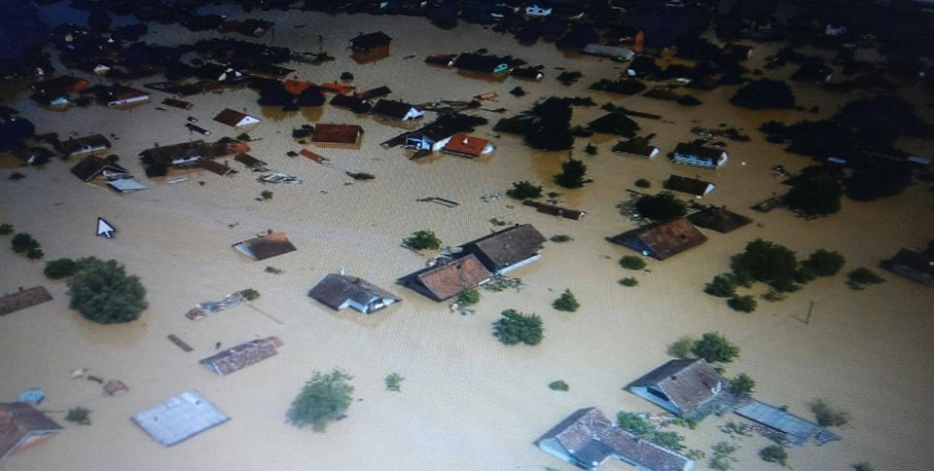
A Year ago
Only water, no people, no animals, no plants
Just a water

Slide 3
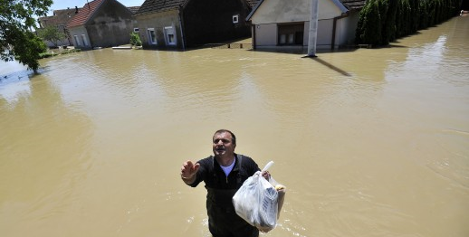
Still there is a man
HE DIDN’T GIVE UP THE ATTEMPT IN DESPAIR. WHAT WOULD YOU SAY, WHAT WOULD YOU DO?
Notes:
I CALLED THE LIONS IN CROATIA TO ACT IMMEDIATELY.

Slide 4
May 18th 2014
The only solution was to act immediately
Lions
LCIF
Public awerness
Friends, family, neighbours

Slide 5
OUR FOUNDATION LCIF
In three days time two Emergency grants were approved
US$ 5,000 for Letovanic flood, early spring
US$ 10,000 for Eastern Slavonia flood
water, hygienic products, blankets, baby food

Slide 6
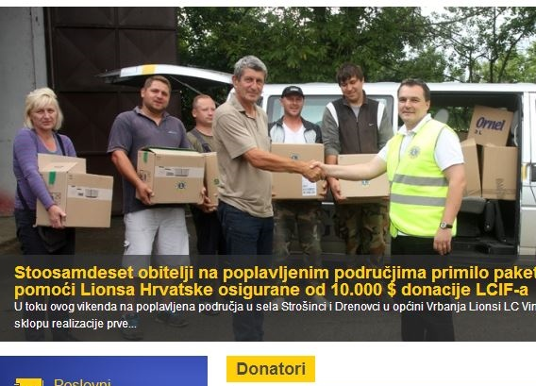
LCIF Emergency Grants

Slide 7
A year later-Spring 2015
The man who didn’t give up is at home now
The children are at school now
People are returning to their rebuilt homes
MCAT Grant ”Let’s equip primary schools in flooded area” completed on 27th March 2015
Great team LCIF&D-126 Croatia

Slide 8
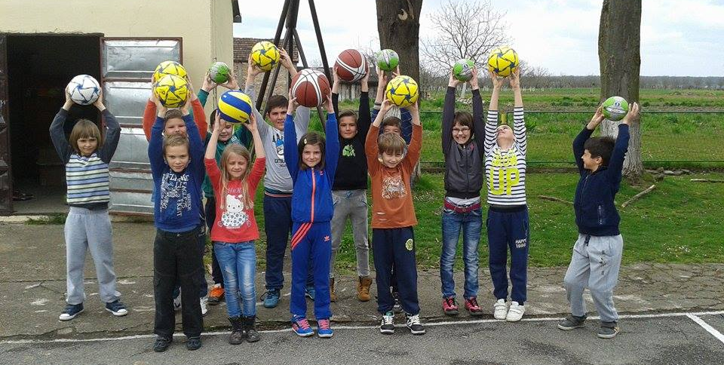
SPORTS FOR ALL WITH LCIF SUPPORT
PRIMARY SCHOOL IN GUNJA 27th MARCH 2015

Slide 9
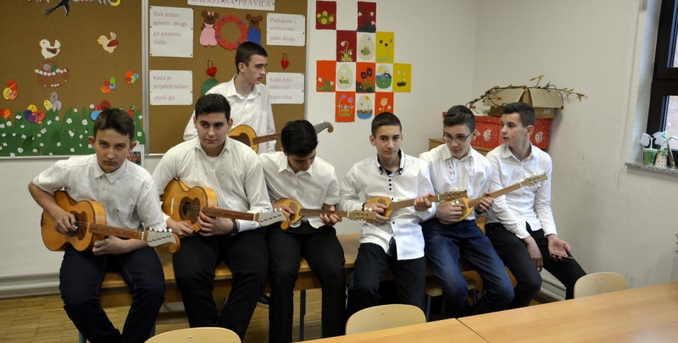
MUSIC FOR ALL WITH LCIF SUPPORT
TAMBURICA THE NATIONAL INSTRUMENT

Slide 10
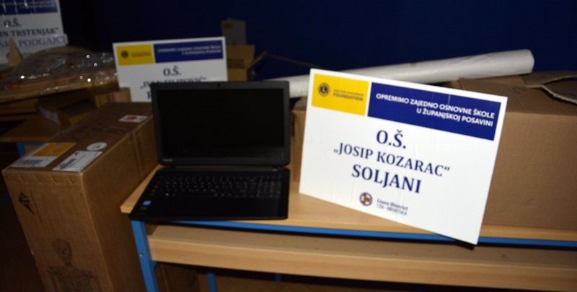
KNOWLEDGE FOR ALL WITH LCIF SUPPORT
BETTER EDUCATION FOR ALL

Slide 11
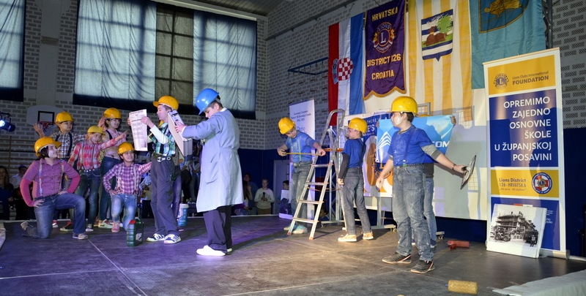
CELEBRATION AT THE END OF THE PROJECT
MUSICAL „WE ARE RUIBILDING OUR SCHOOL” PERFORMED AND WRITTEN BY PUPILS

Slide 12
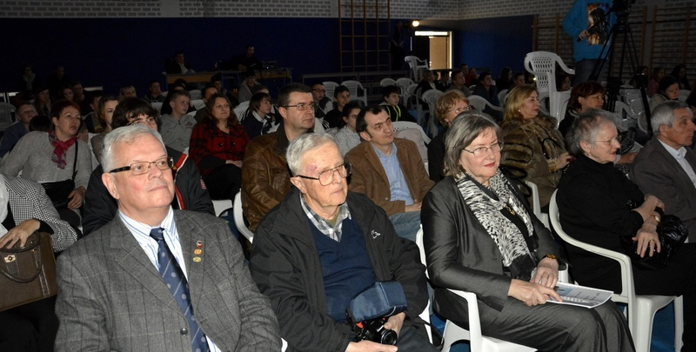
PROUD TO BE LION
DG DARIO BOGNOLO AND IPDG NADA ARBANAS

Slide 13
OUR MAIN GOALS
To reach the most vunerable group-children in elementary schools
To ensure better standard of teaching process
To connect and create bond with the community full of grief
To improve the psychological & psychical state of children

Slide 14
We gained what we aimed at
We completed the project according to LCIF regulations and policies
We equiped the school cabinets for maths, physics, chemistry, informatics, biology, history and geography
We brought joy to children with tamburica instruments and different items for physical education

Slide 15
This is the story about the leadership and teamwork
There were three teams working hard
One in USA-LCIF
One in Croatia-Lions District 126
One in flooded area-teachers, self-government representatives, students
Special thanks go to Julie Boonprasarn, Katarina Pisacic and Zlatko Jankovic-Milos
Thank you all
Osijek, 22nd May 2015 Nada

